Slide 1
DALAC
Workspace Management System
David Luco, Anita Sharma, Collin Sullivan, Amanda Ali, Luke Stigdon

Slide 2
Overview
This goal of this project is to provide the following benefits:
More efficient utilization of office space
Reduce costs spent on new spaces that are unnecessary
Increase employee productivity through work environment flexibility

Slide 3
DFDs

Slide 4
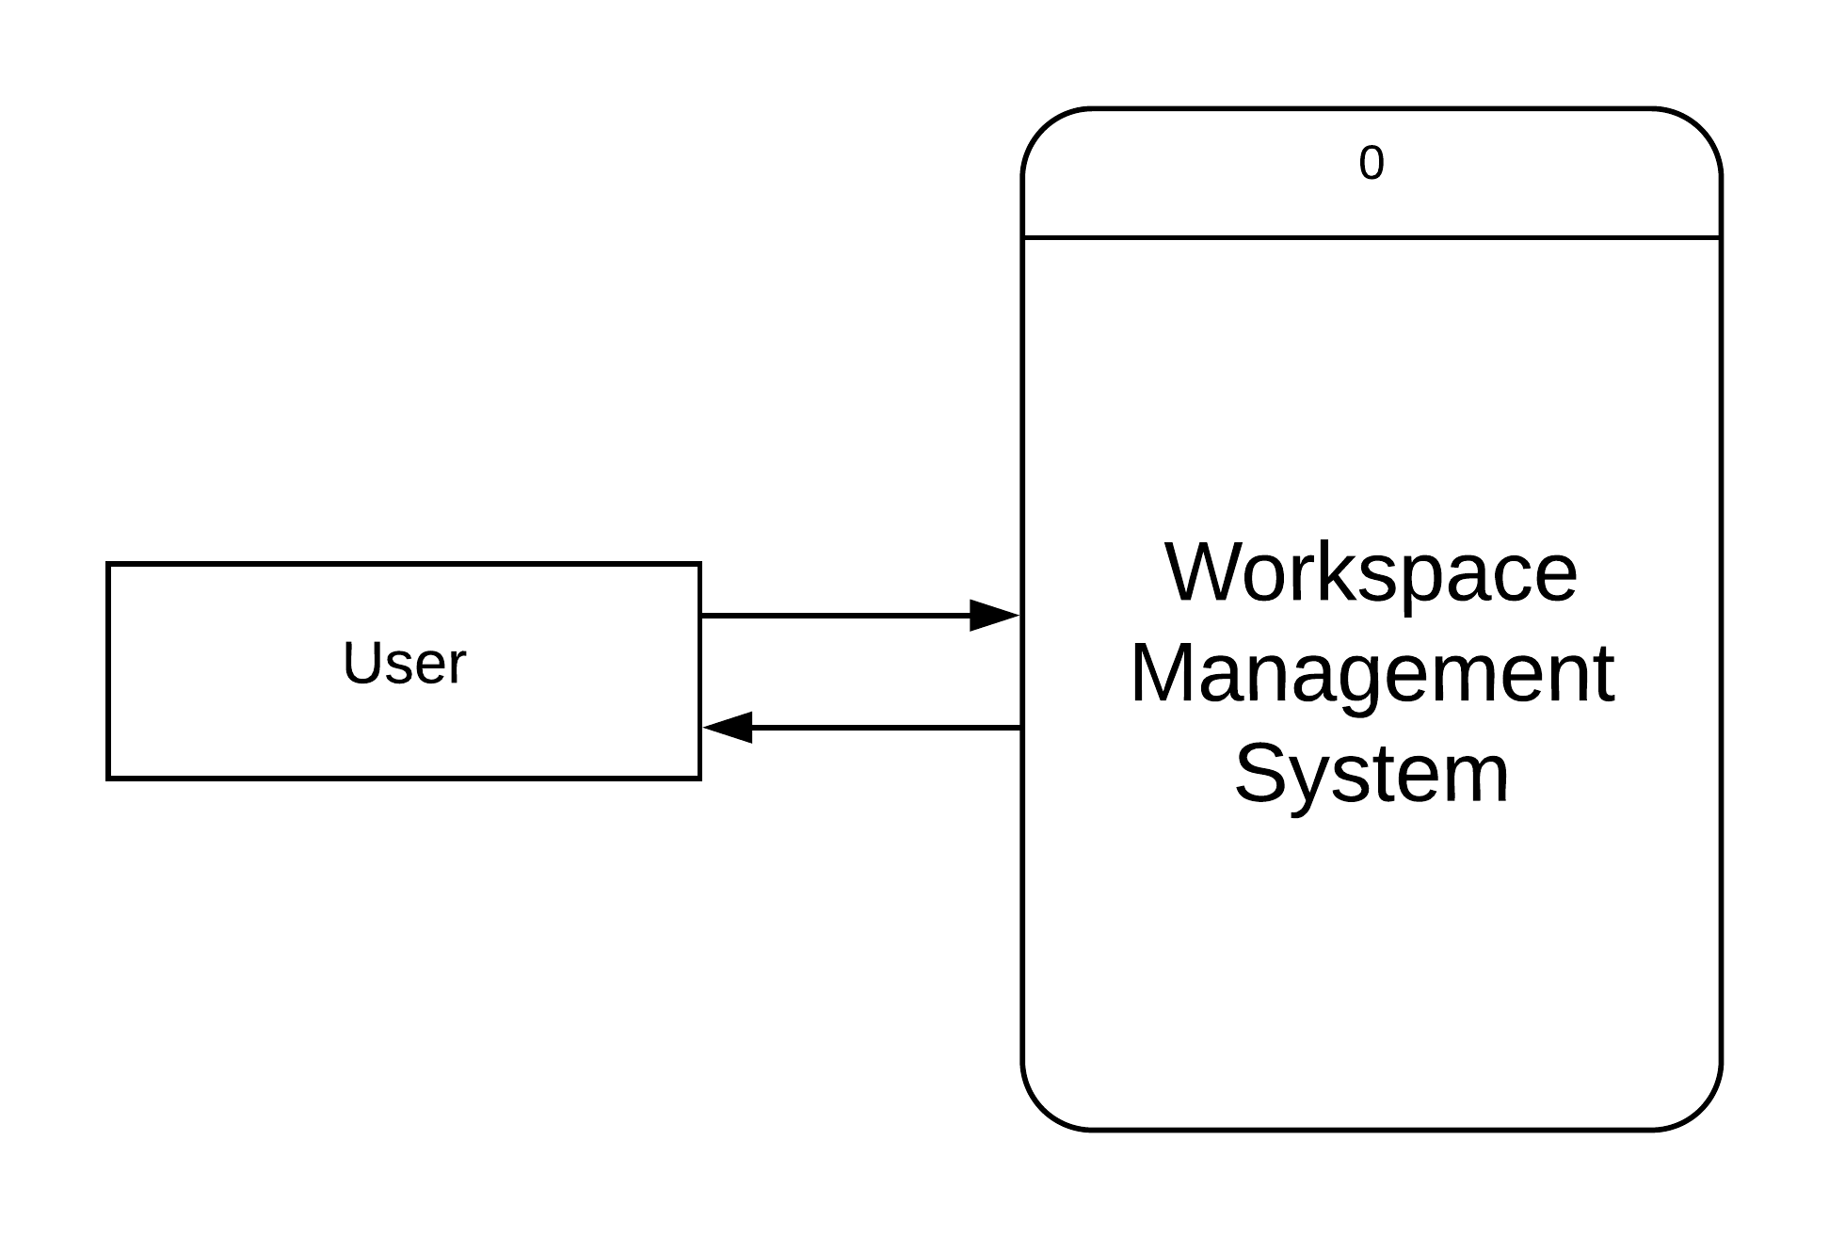
Context Diagram

Slide 5
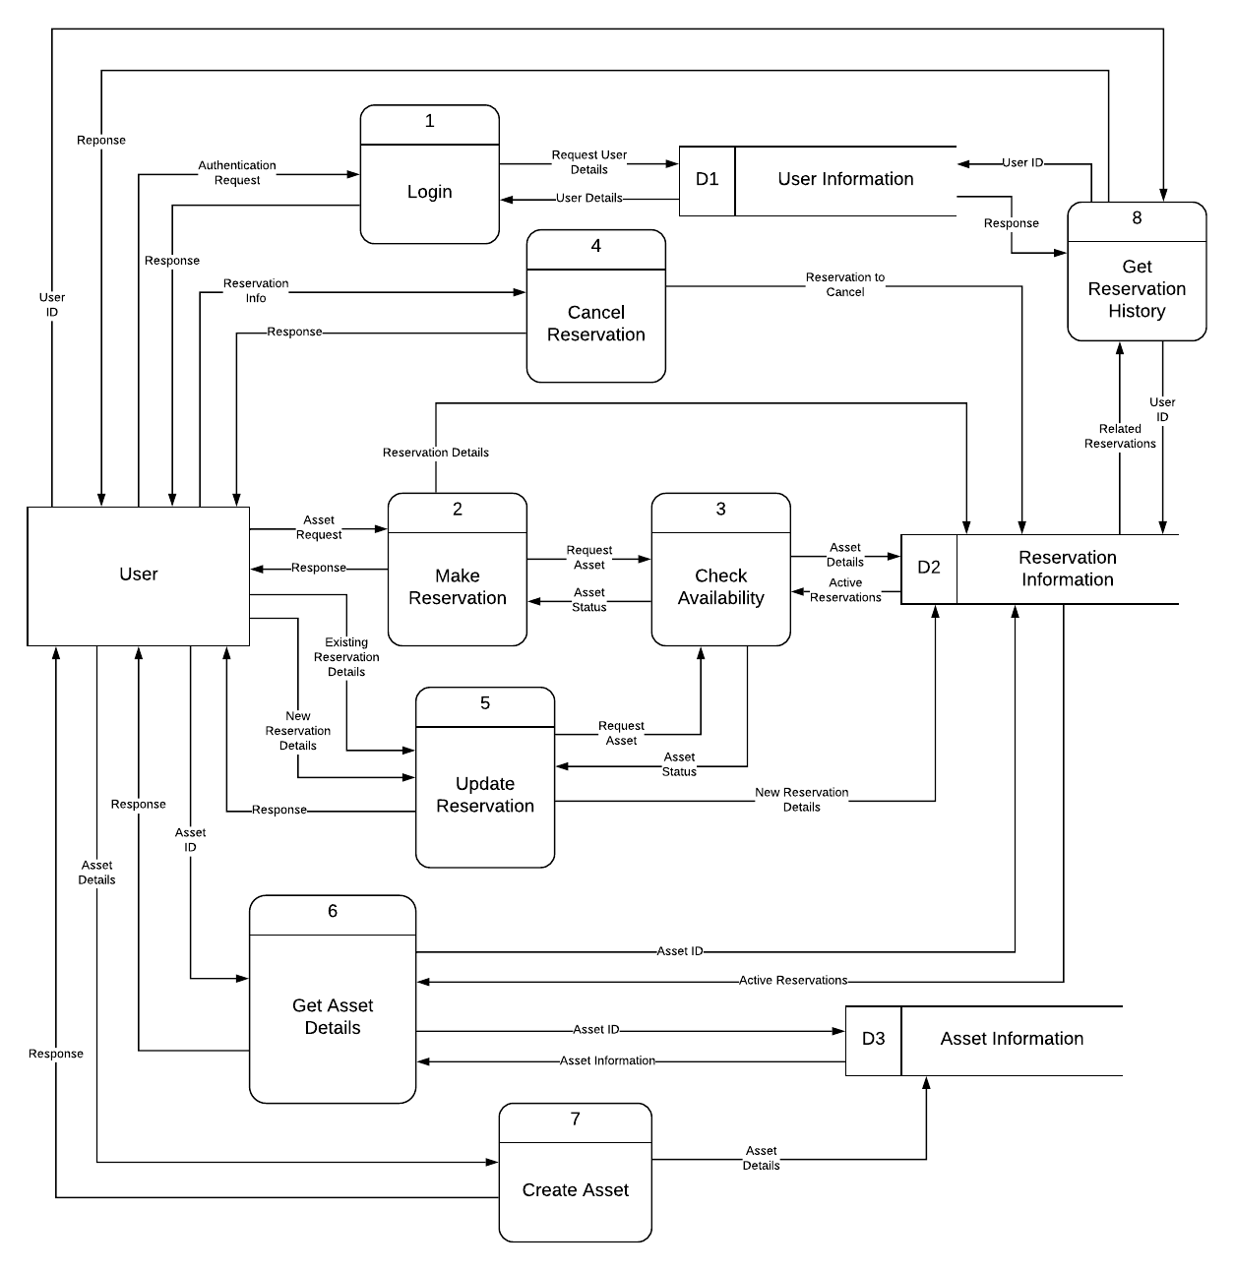
Level Zero

Slide 6
Level 1 Diagrams

Slide 7
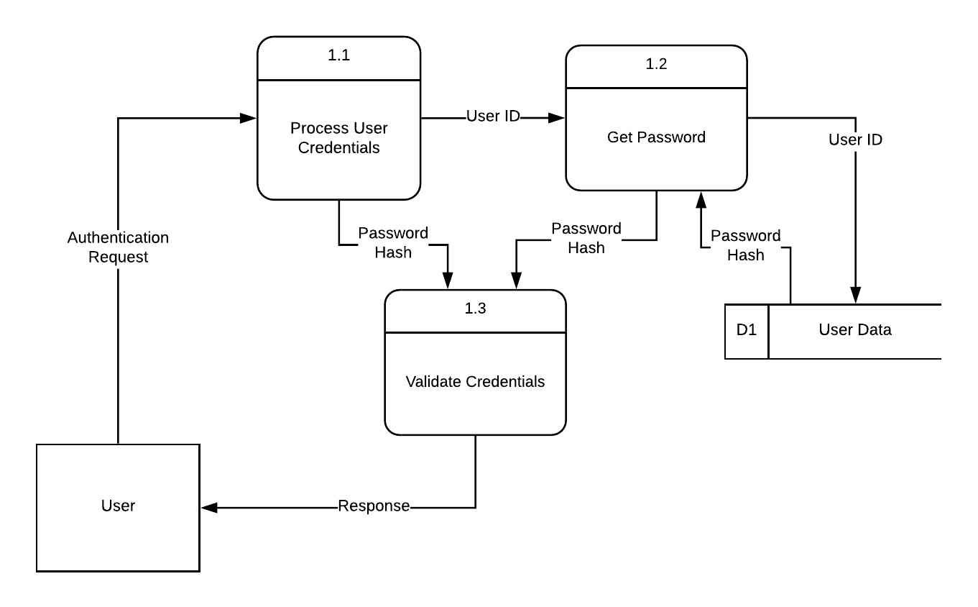
Process 1

Slide 8
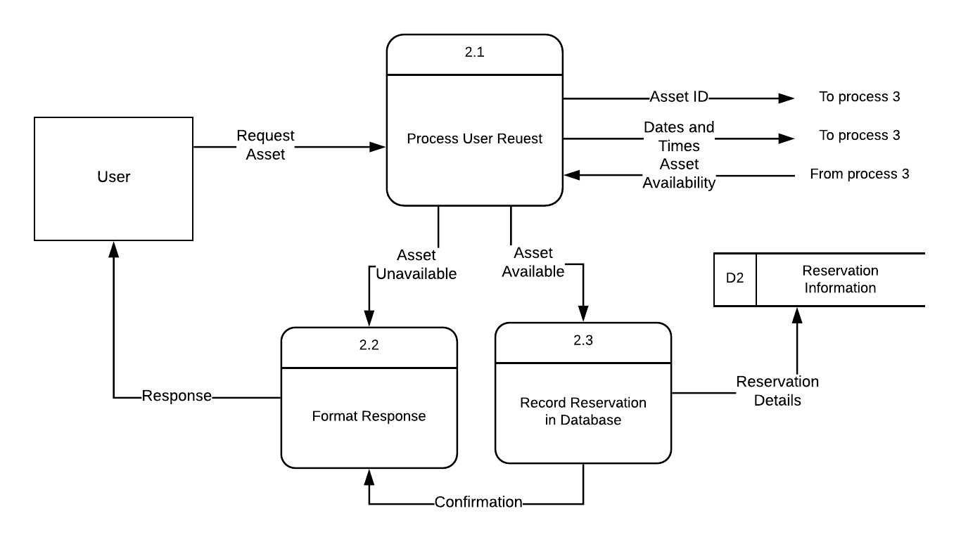
Process 2

Slide 9
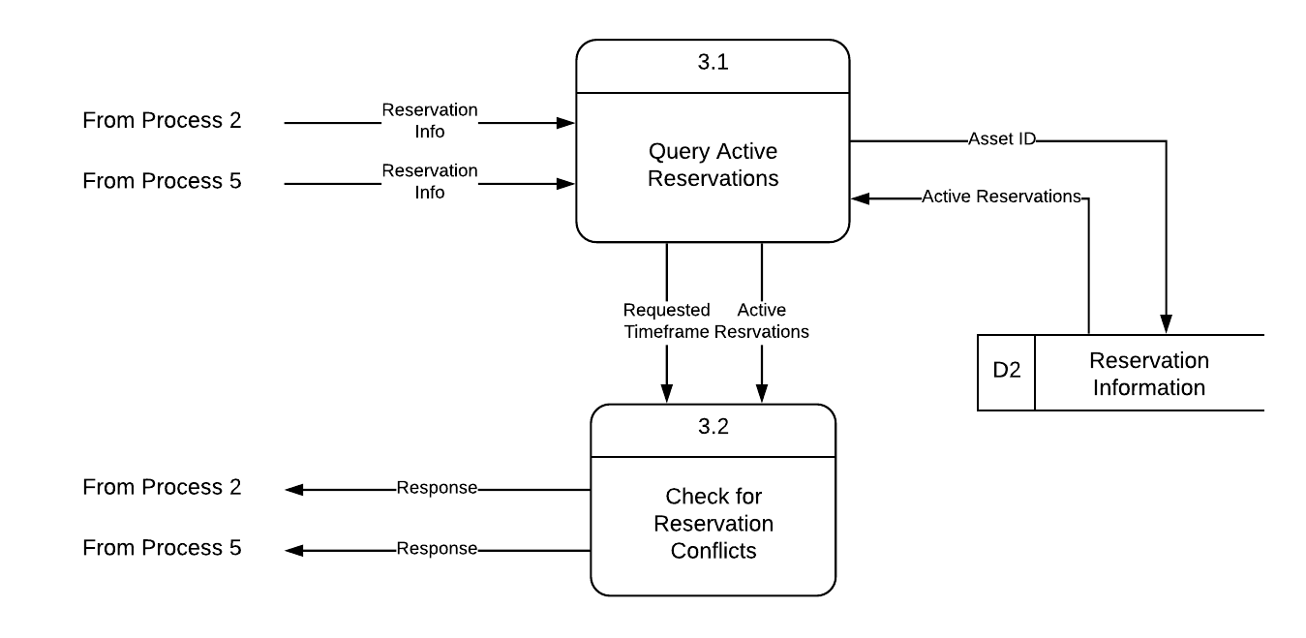
Process 3

Slide 10
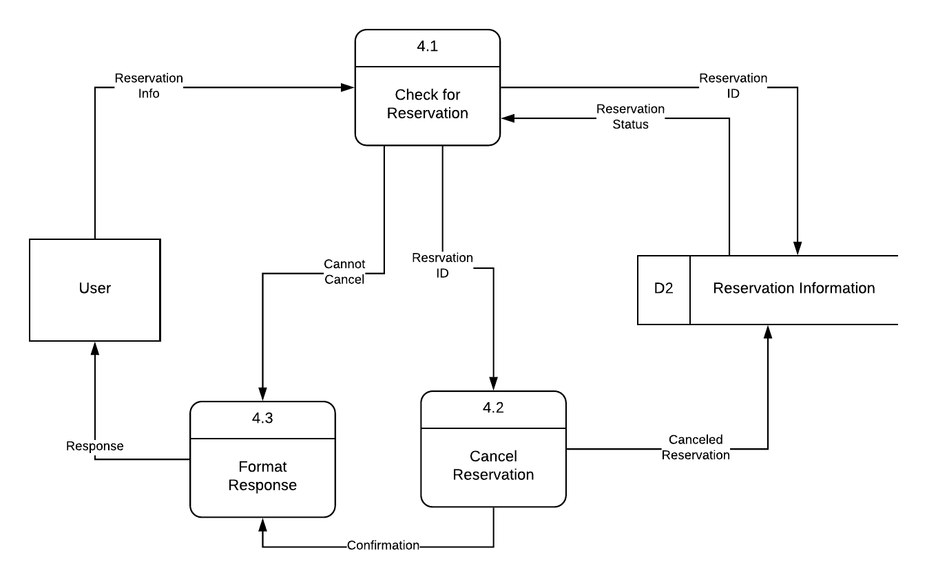
Process 4

Slide 11
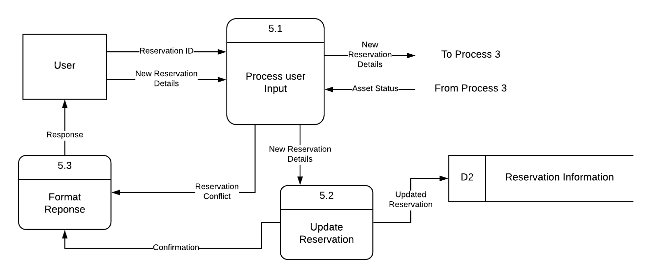
Process 5

Slide 12
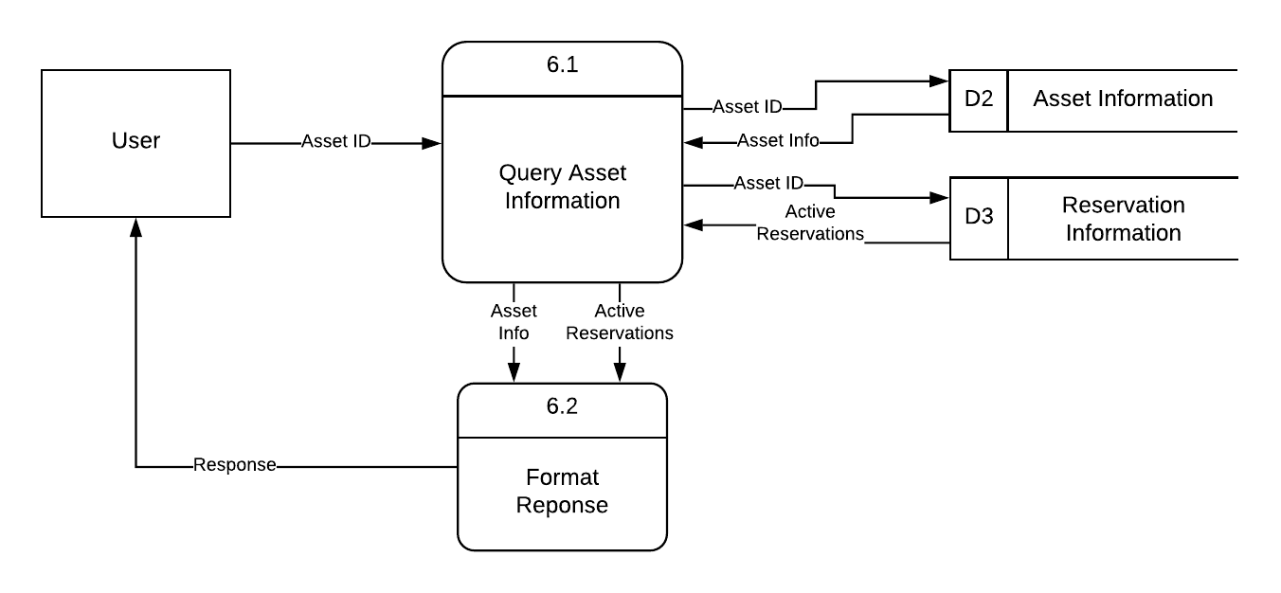
Process 6

Slide 13
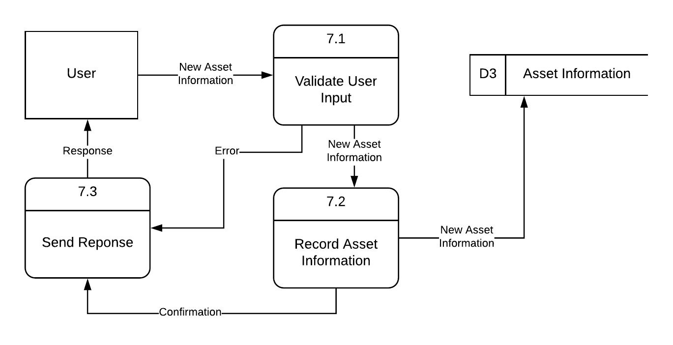
Process 7

Slide 14
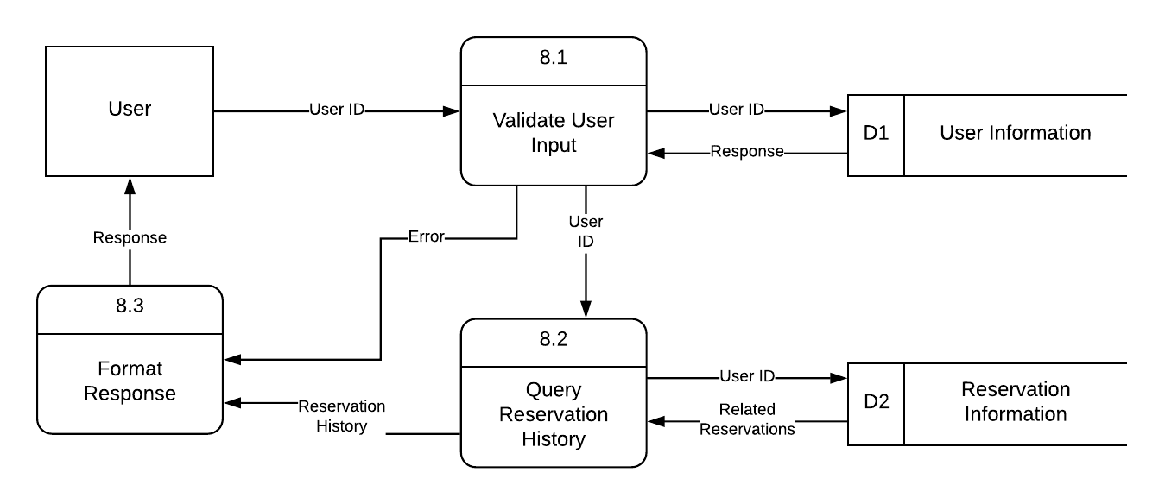
Process 8

Slide 15
Project Plan (~2 weeks)
Phase 1 - Days 1-3
Project was broken up into discrete components and assigned to each team member through Trello
Phase 3 - Days 10-13
Final edits made by team members, and deliverable components were submitted for review
Implementation
Completion
Planning & Analysis
Review
Phase 2 - Days 3-10
Team members worked on their individual components and updated their status in Trello
Phase 4 - Day 14
Final review of the deliverable and completion of the presentation

